Slide 1
Rigor Motor Data Analysis
Aleksandar Bahat

Slide 2
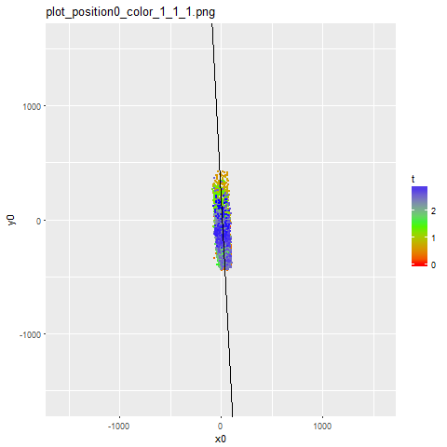
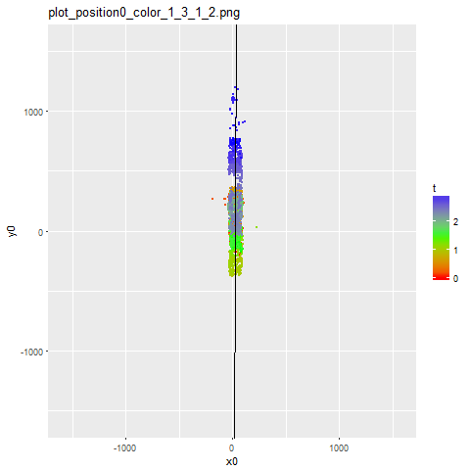
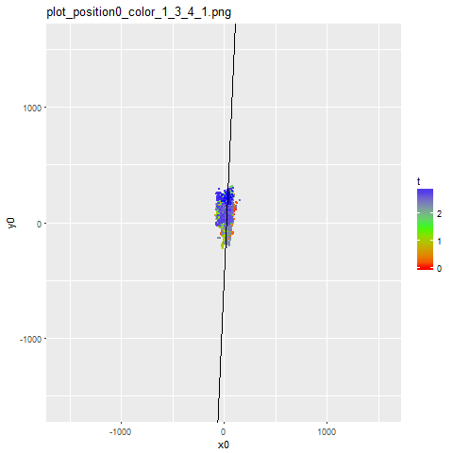
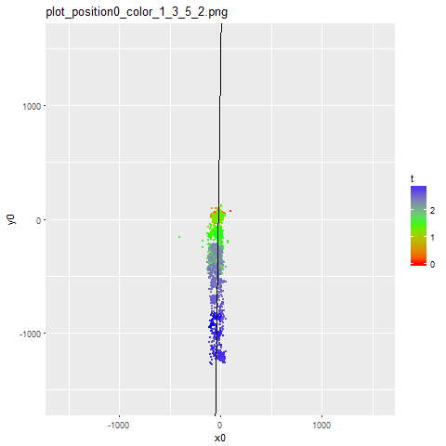
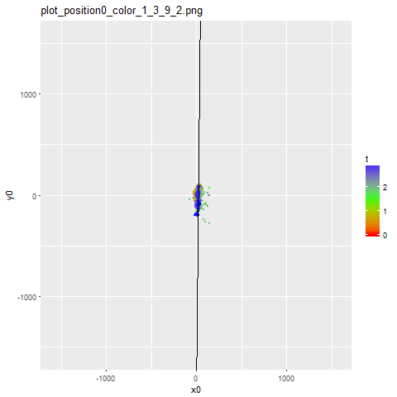
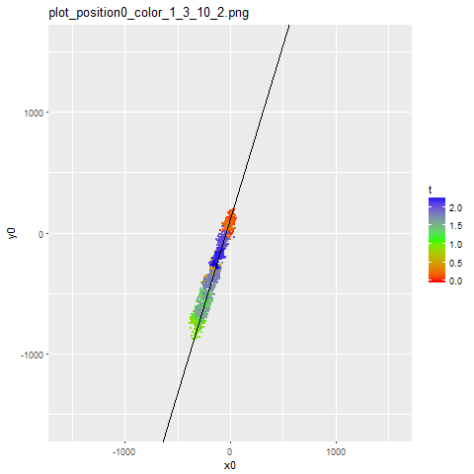
Original results: some typical cargo paths
(lengths in nanometers, estimated “microtubule line” superimposed)

Slide 3
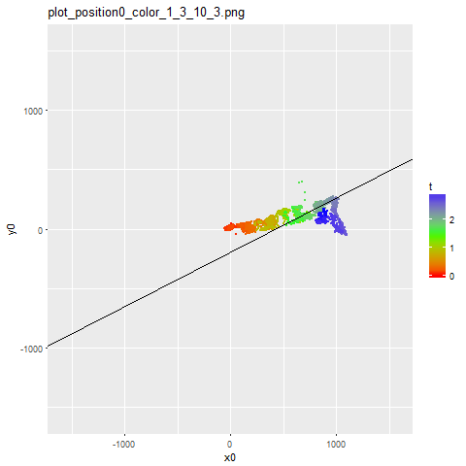
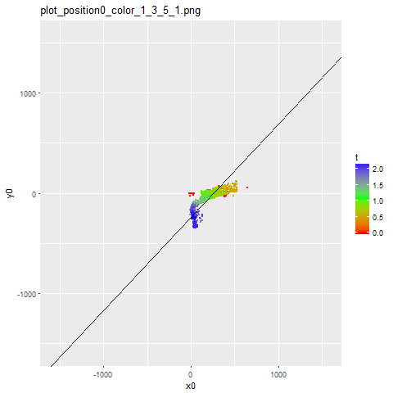
Original results: some atypical cargo paths
(lengths in nanometers, estimated “microtubule line” superimposed)
Appear to be switching from one microtubule to another during observation period

Slide 4
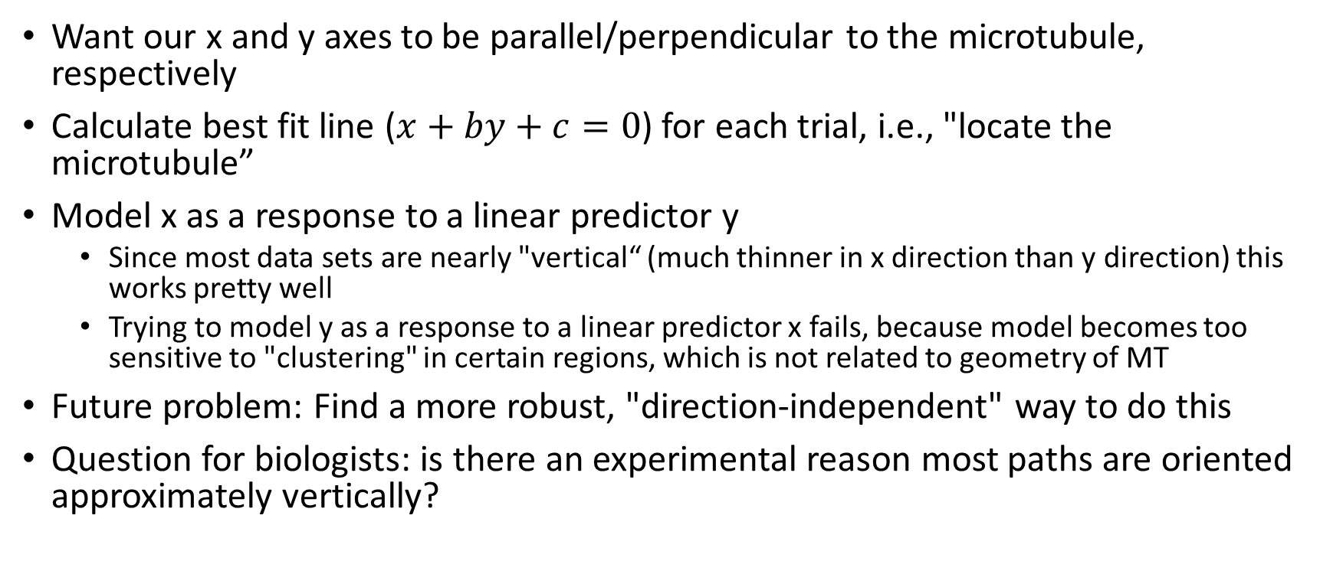
Transformation to “natural” coordinates
Want our x and y axes to be parallel/perpendicular to the microtubule, respectively
Calculate best fit line ($x+by+c=0$) for each trial, i.e., "locate the microtubule”
Model x as a response to a linear predictor y
Since most data sets are nearly "vertical“ (much thinner in x direction than y direction) this works pretty well
Trying to model y as a response to a linear predictor x fails, because model becomes too sensitive to "clustering" in certain regions, which is not related to geometry of MT
Future problem: Find a more robust, "direction-independent" way to do this
Question for biologists: is there an experimental reason most paths are oriented approximately vertically?

Slide 5
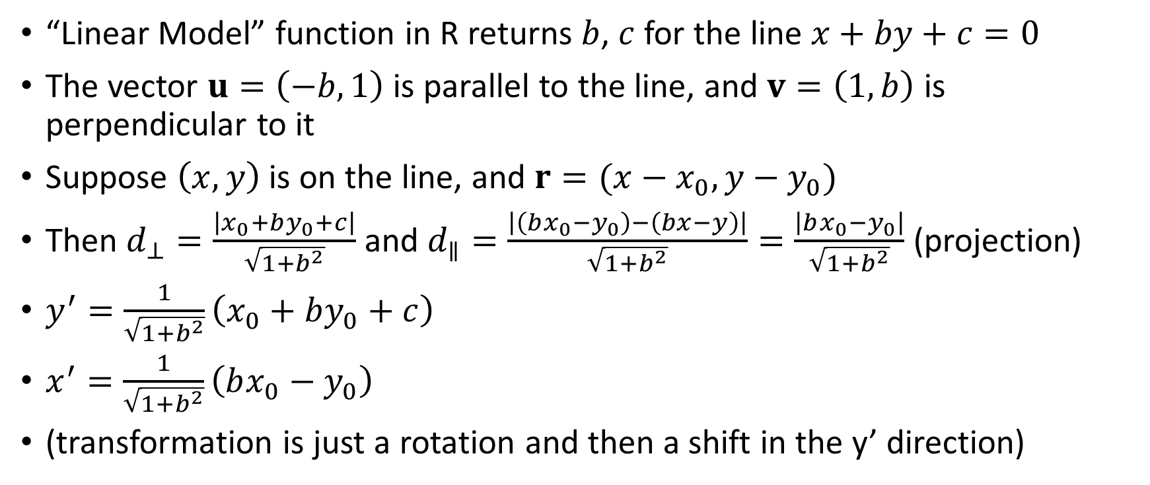
Transformation to “natural” coordinates, continued
“Linear Model” function in R returns $b$, $c$ for the line $x+by+c=0$
The vector $u=\left(−b,1\right)$ is parallel to the line, and $v=\left(1, b\right)$ is perpendicular to it
Suppose $\left(x,y\right)$ is on the line, and $r=(x−x_{0},y−y_{0})$
Then $d_{⊥}=\frac{\left|x_{0}+by_{0}+c\right|}{\sqrt{1+b^{2}}}$ and $d_{∥}=\frac{\left|\left(bx_{0}−y_{0}\right)−\left(bx−y\right)\right|}{\sqrt{1+b^{2}}}=\frac{\left|bx_{0}−y_{0}\right|}{\sqrt{1+b^{2}}}$ (projection)
$y^{′}=\frac{1}{\sqrt{1+b^{2}}}\left(x_{0}+by_{0}+c\right)$
$x^{′}=\frac{1}{\sqrt{1+b^{2}}}\left(bx_{0}−y_{0}\right)$
(transformation is just a rotation and then a shift in the y’ direction)

Slide 6
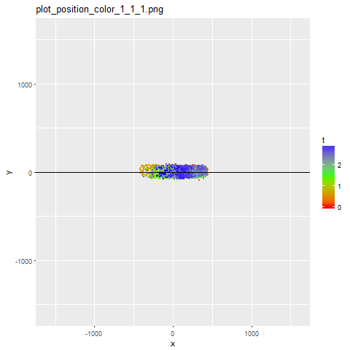
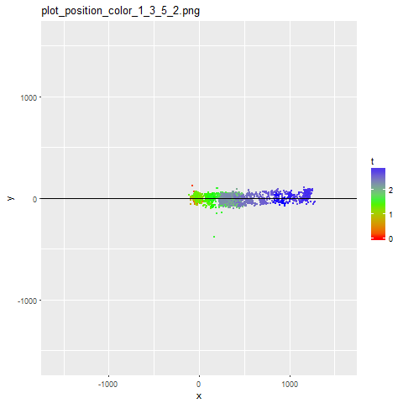
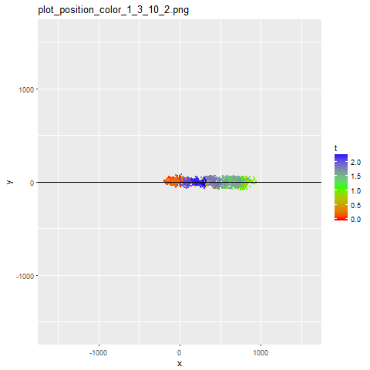
Compare: original and transformed results
original
transformed

Slide 7
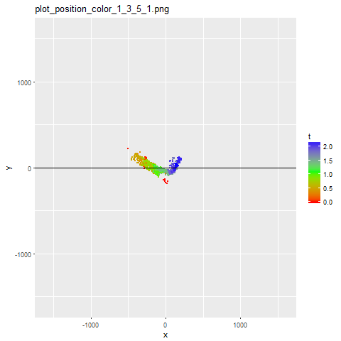
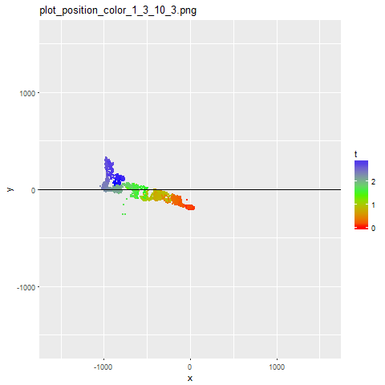
Exceptions
To be expected, since the fitted line is off for these
Future problem, tougher than direction-independent fitting: multiple-line fitting?
original
transformed

Slide 8
Characterizing paths by MSD
Pinned: linear, then asymptotically constant
Skating: linear, then asymptotically linear (with a new slope)
Ballistic: quadratic
Computed MSD in the x (parallel) and y (perpendicular) components individually, as well as the total

Slide 9
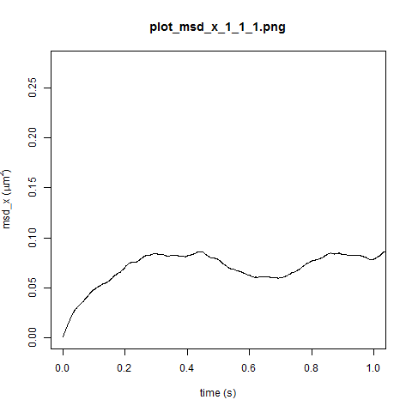
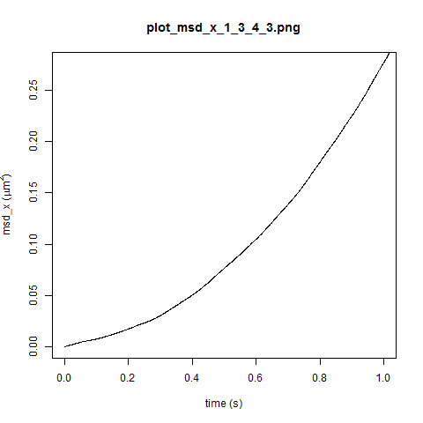
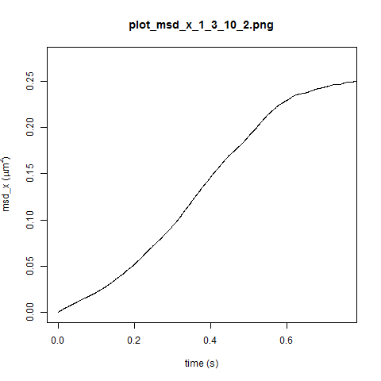
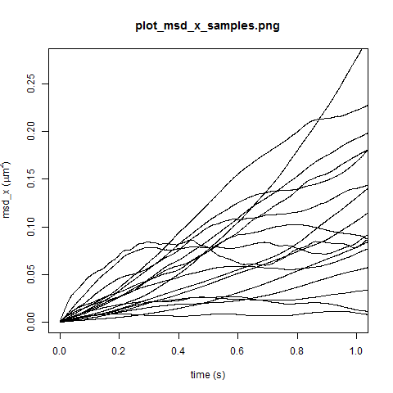
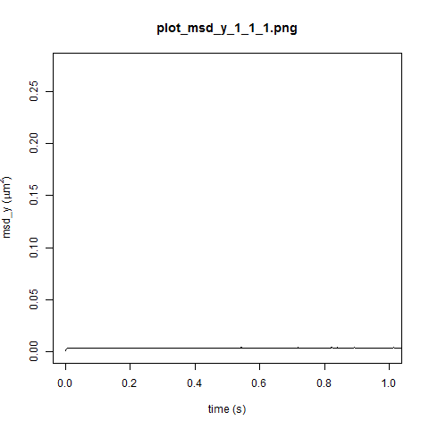
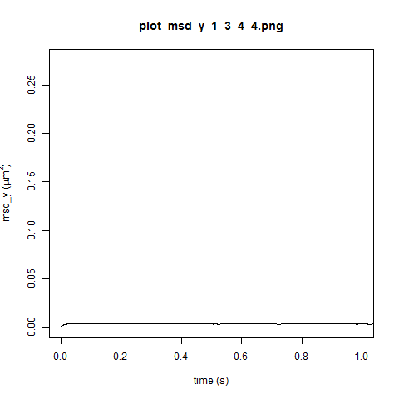
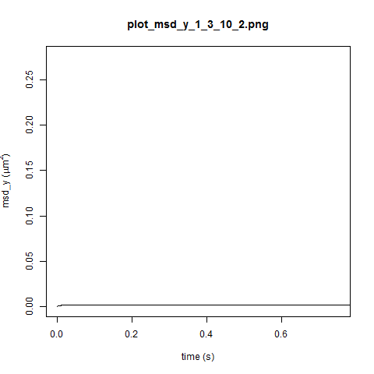
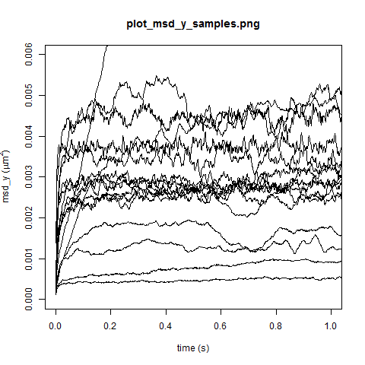
MSD results (same scale for comparison)
MSD in x direction always dominates MSD in y direction (on the order of 10 or even 100 times greater)
Therefore total MSD is approximately equal to MSD in x direction

Slide 10
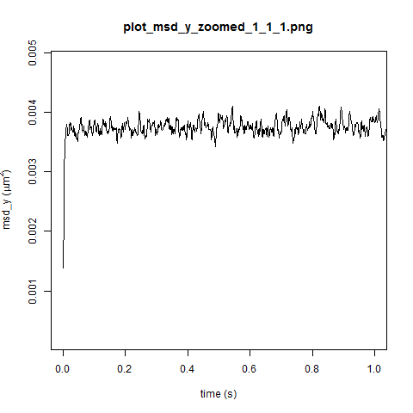
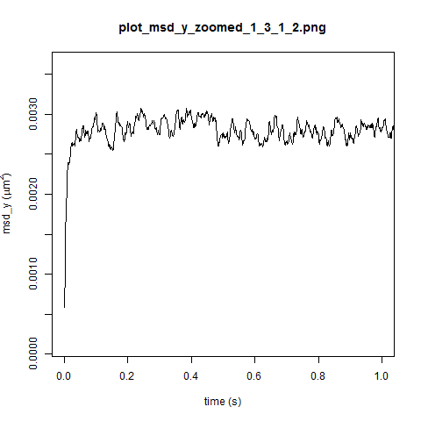
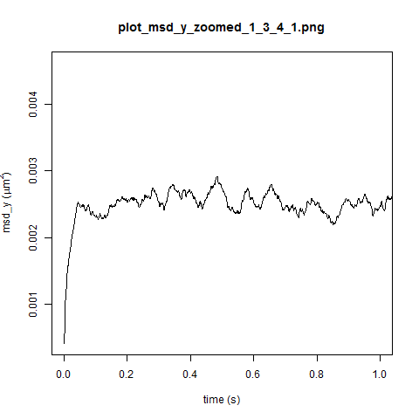
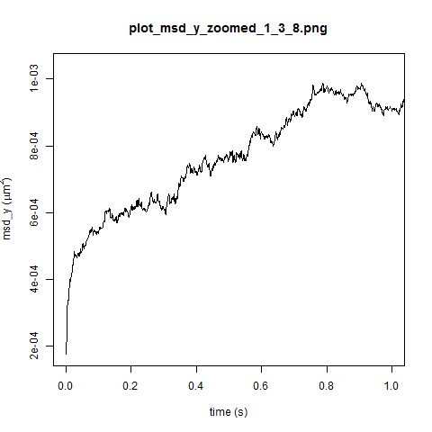
MSD in y direction – a closer look
Although MSD-y is negligible compared to MSD-x (most drifting is along the microtubule, not towards/away from it), MSD-y shows interesting behavior on closer inspection
Most act like we expect from pinned diffusion
A few act like we expect from skating diffusion
Why do we see this behavior in the y direction?

Slide 11
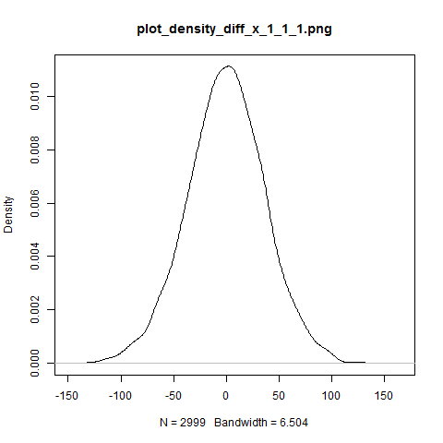
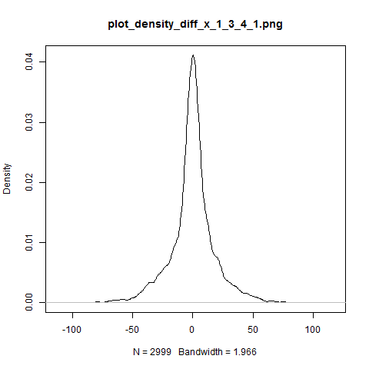
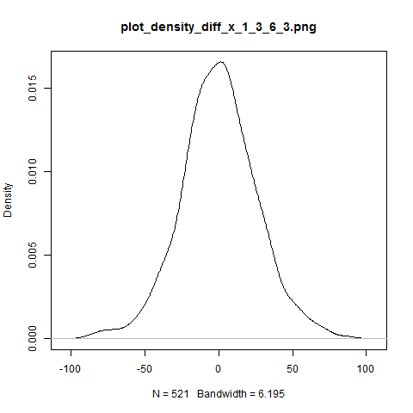
Other statistics: distribution of x increments
All are approximately Gaussian (peak is often a bit sharp)

Slide 12
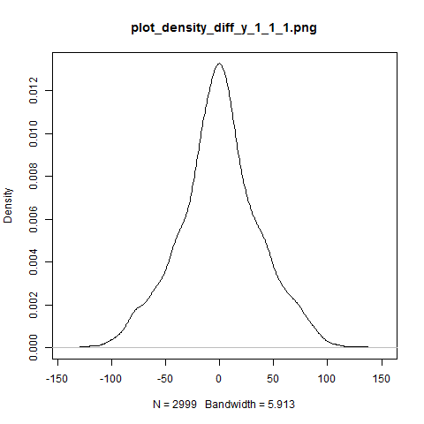
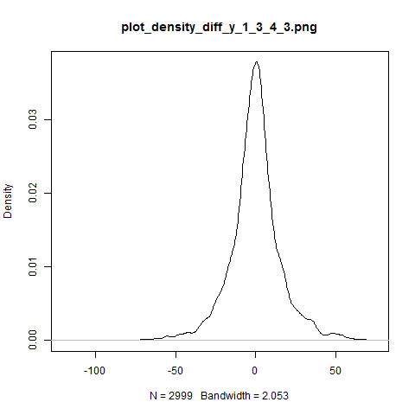
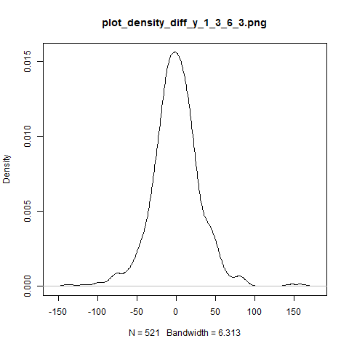
Other statistics: distribution of y increments
Like x-increments, nearly Gaussian

Slide 13
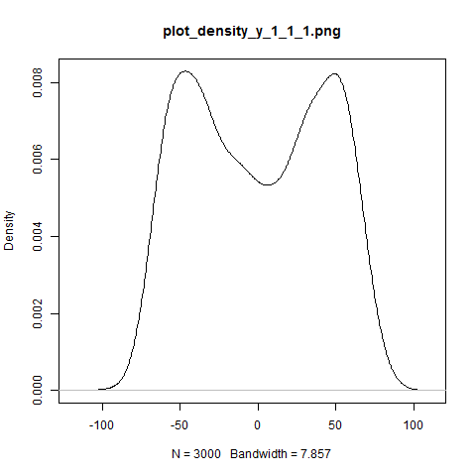
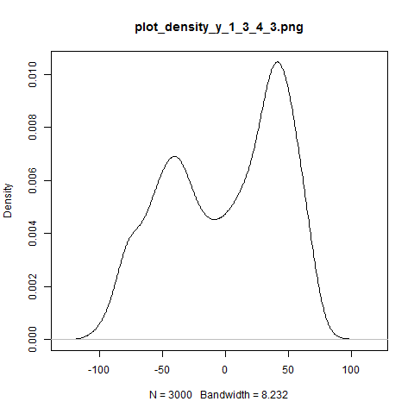
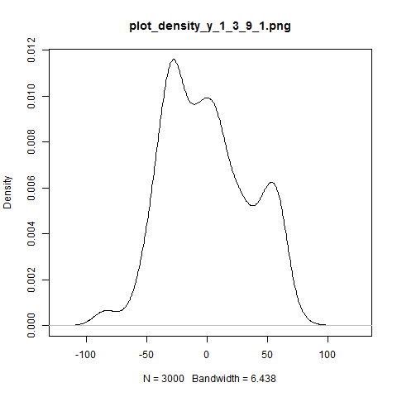
Other statistics: distribution of y positions
Expect Gaussianity for Hookean spring; but most are bimodal or otherwise far from being Gaussian
Statistical artifact? Experimental error? Real physical dynamics?

Slide 14
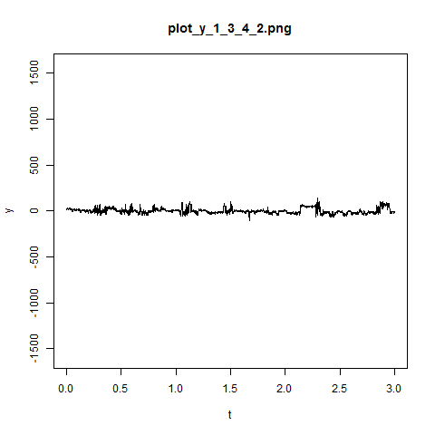
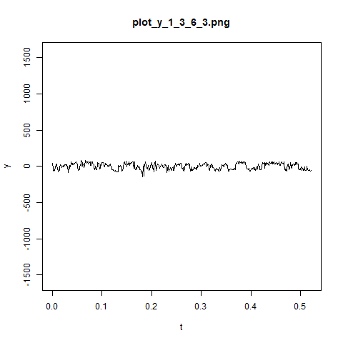
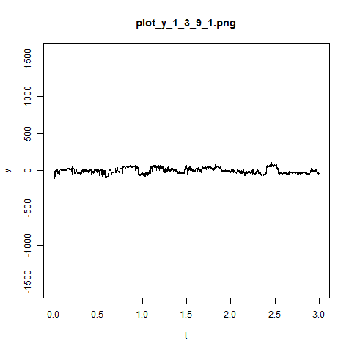
Continued: y positions (zoomed in)
What’s keeping the y’s away from the middle?

Slide 15
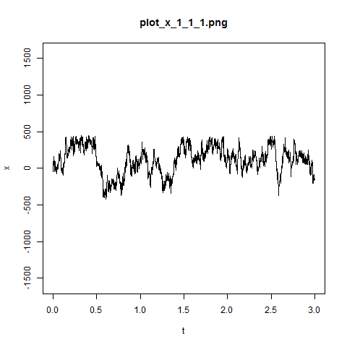
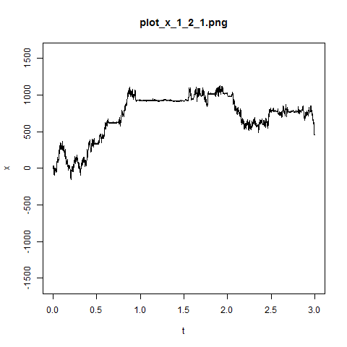
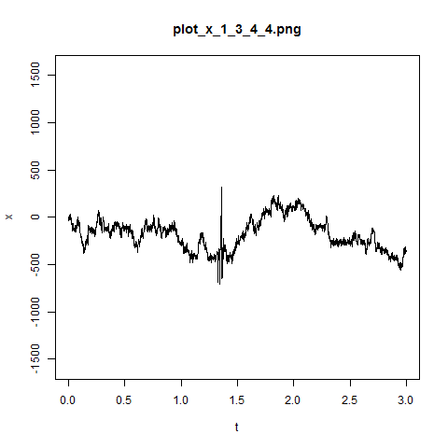
x positions
Many trials show “diffuse then stick” behavior
(Occasional big jumps/outliers – probably experimental error)

